Slide 1
Logistics Optimization for Delivery Routes – Amazon
Name: Mohammad Taha
Batch: Data Science Batch – 15 December
Project: SQL Logistics Analytics

Slide 2
Project Overview
Amazon handles millions of shipments daily through a large logistics network including warehouses, routes, and delivery agents.
Delivery delays and inefficient routes can impact customer satisfaction and operational costs.
This project analyzes logistics data using SQL to identify delays, optimize routes, evaluate warehouse performance, and improve delivery efficiency.

Slide 3
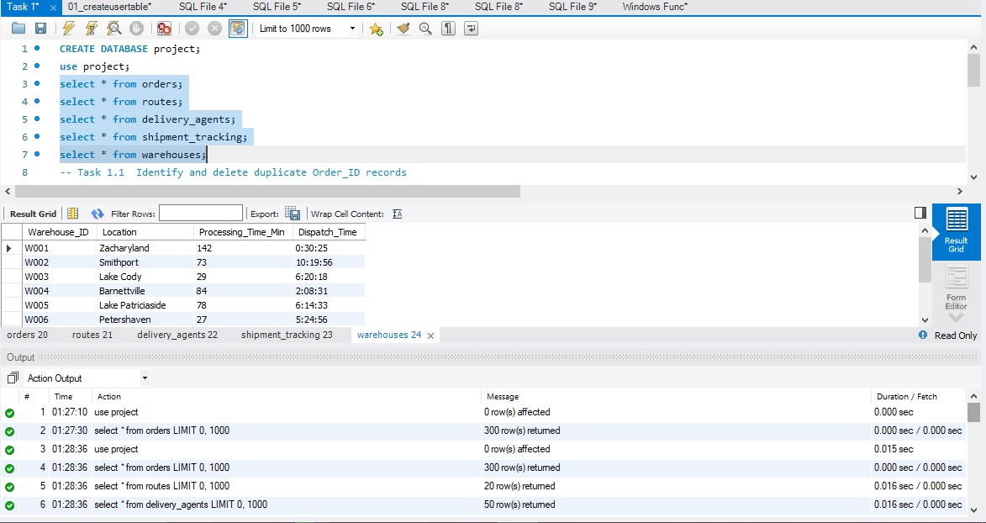
Dataset Description

Slide 4
Task 1: Data Cleaning & Preparation
Data cleaning was performed to ensure data accuracy and reliability before analysis.
The following steps were performed:
• Identified and removed duplicate Order_ID records
• Replaced missing Traffic_Delay_Min values
• Standardized date formats
• Validated delivery date consistency

Slide 5
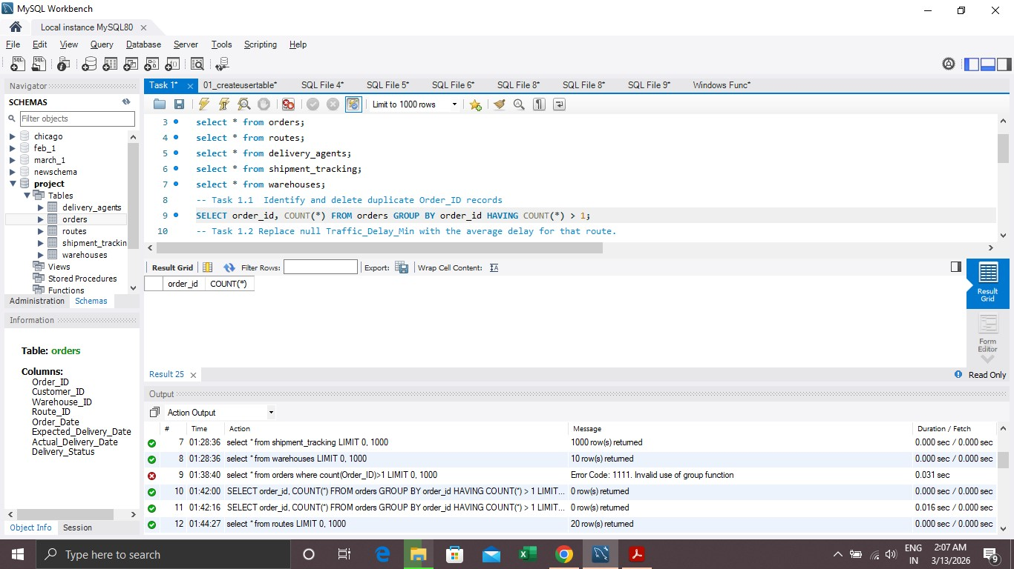
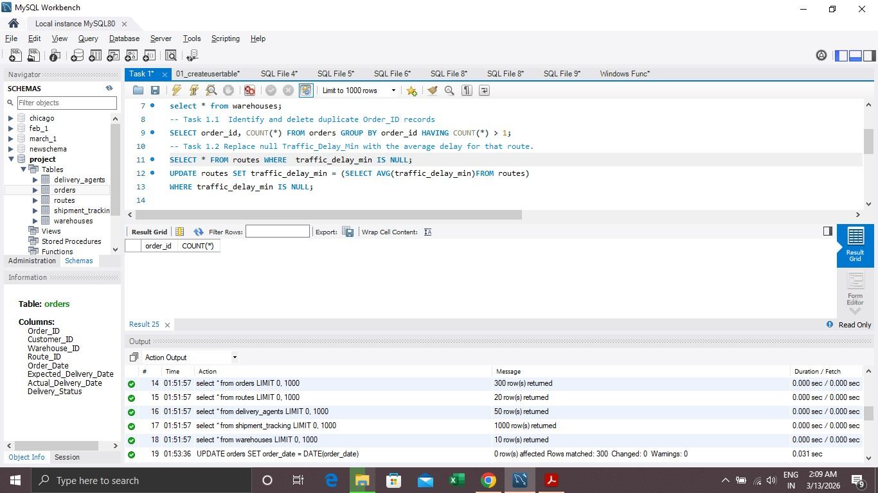
Task 1 SQL Queries + Results
Task 1.1 Identify and delete duplicate Order_ID records • SELECT order_id, COUNT(*) FROM orders GROUP BY order_id HAVING COUNT(*) > 1; Insights :- No duplicate Order_ID records were found in the dataset. Task 1.2 Replace null Traffic_Delay_Min with the average delay for that route. • SELECT * FROM routes WHERE traffic_delay_min IS NULL; • UPDATE routes SET traffic_delay_ min = (SELECT AVG(traffic_delay_min) FROM routes) WHERE traffic_delay_min IS NULL;

Slide 6
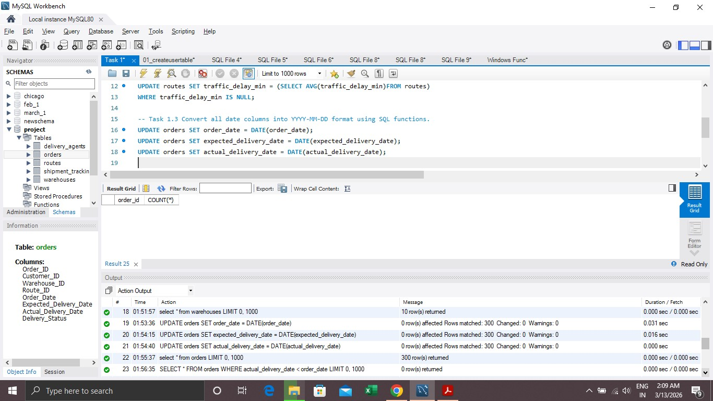
Insights:- Missing traffic delay values were replaced using the average traffic delay.
Task 1.3 Convert all date columns into YYYY-MM-DD format using SQL functions. • UPDATE orders SET order_date = DATE(order_date); • UPDATE orders SET expected_delivery_date = DATE(expected_delivery_date); • UPDATE orders SET actual_delivery_date = DATE(actual_delivery_date); Insights :- No invalid records were found where the actual delivery date occurred before the order date.

Slide 7
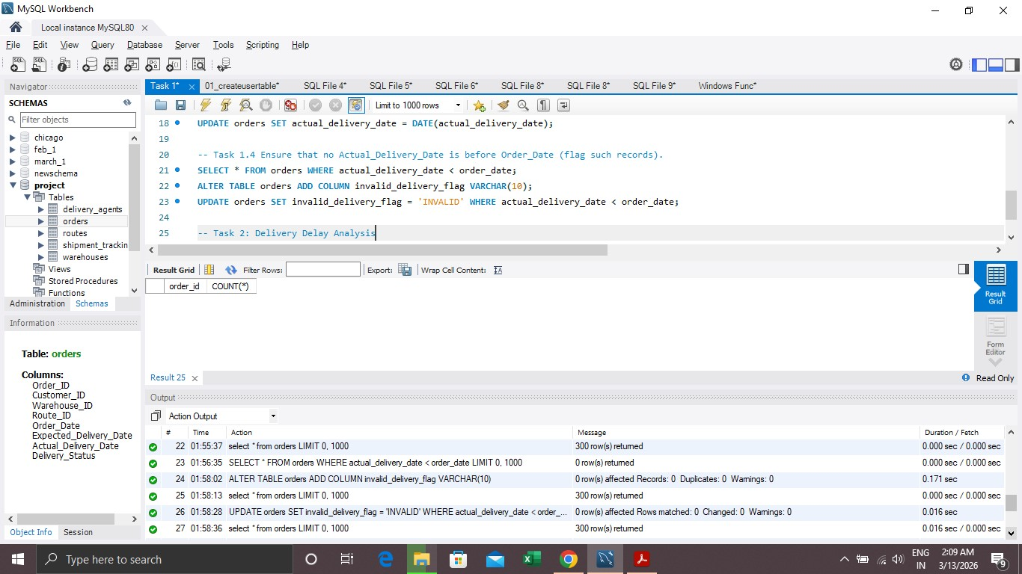
Task 1.4 Ensure that no Actual_Delivery_Date is before Order_Date (flag such records).
• SELECT * FROM orders WHERE actual_delivery_date < order_date; • ALTER TABLE orders ADD COLUMN invalid_delivery_flag VARCHAR(10); • UPDATE orders SET invalid_delivery_flag = 'INVALID’ WHERE actual_delivery_date < order_date;

Slide 8
Task 2: Delivery Delay Analysis
Delivery delay analysis was performed to identify delayed shipments and inefficient delivery routes.
The following analysis was conducted:
• Calculated delivery delay for each order
• Identified top delayed routes based on average delay
• Ranked orders by delay within each warehouse using window functions

Slide 9
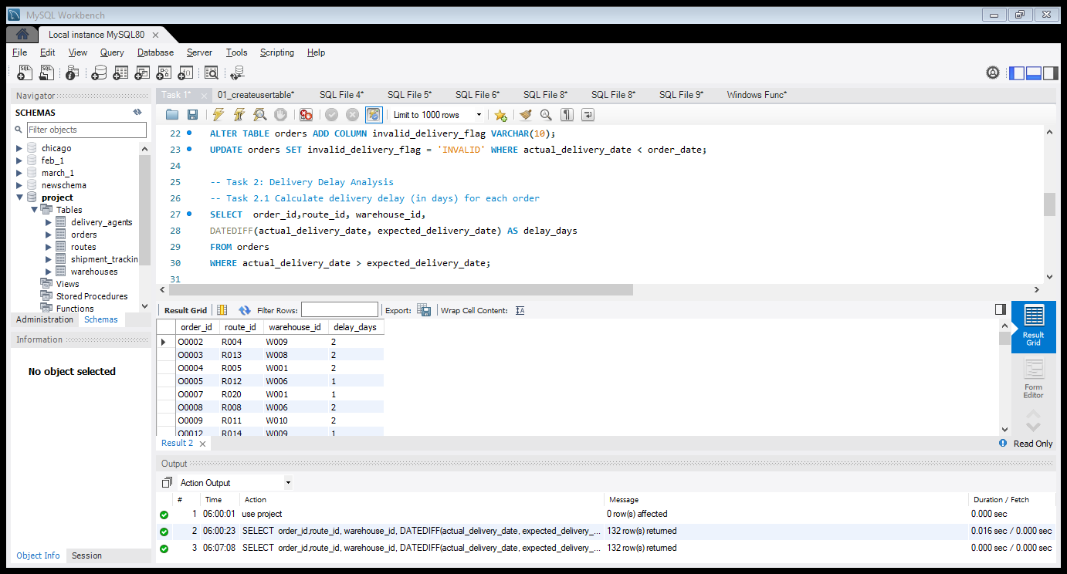
Task 2.1 Calculate delivery delay (in days) for each order
SELECT order_id,route_id, warehouse_id, DATEDIFF(actual_delivery_date, expected_delivery_date) AS delay_days FROM orders WHERE actual_delivery_date > expected_delivery_date; Insights :- Delivery delay was calculated as the difference between actual delivery date and expected delivery date.
Positive values indicate delayed deliveries while zero indicates on-time delivery.

Slide 10
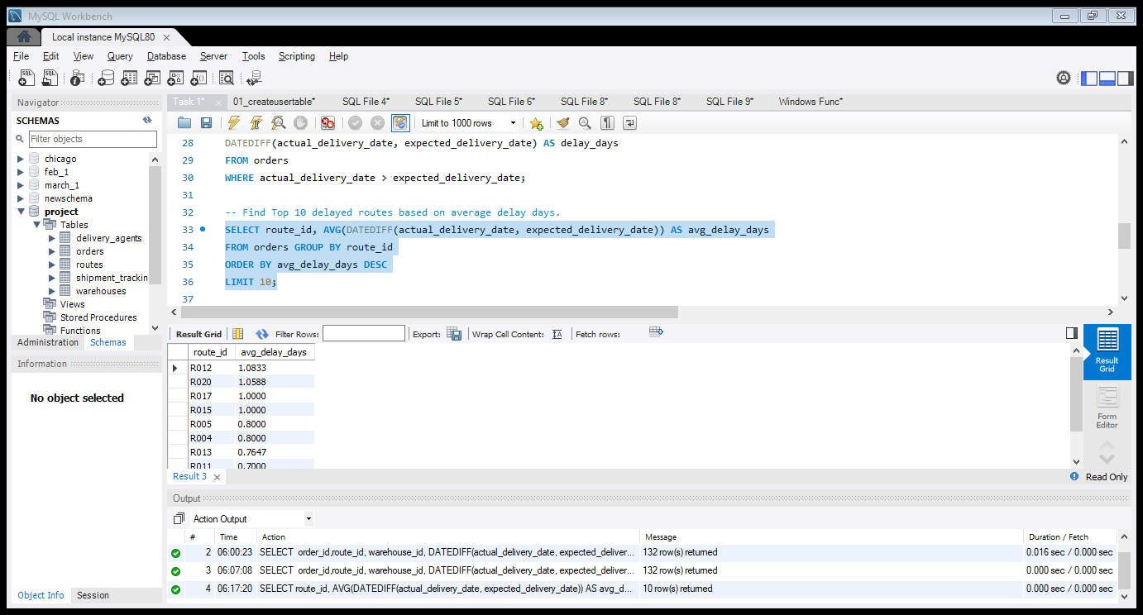
Task 2.2 Find Top 10 delayed routes based on average delay days
• SELECT route_id, AVG(DATEDIFF(actual_delivery_date, expected_delivery_date)) AS avg_delay_daysFROM orders GROUP BY route_id ORDER BY avg_delay_days DESCLIMIT 10; Insights:- Certain routes show significantly higher delivery delays, indicating potential issues such as traffic congestion or inefficient routing.

Slide 11
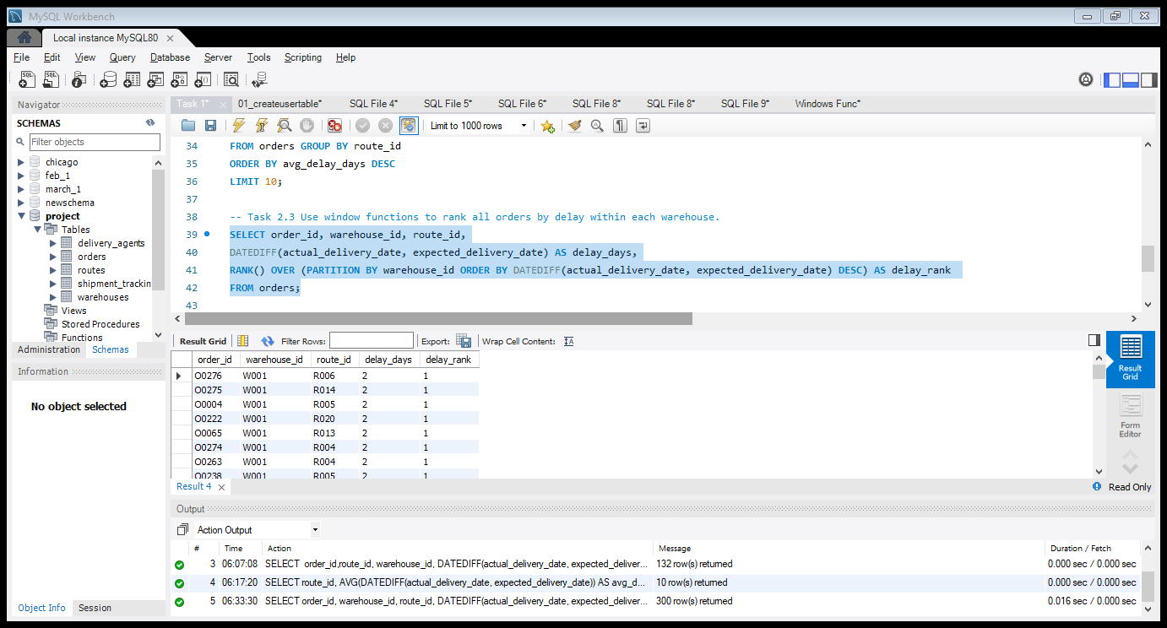
Task 2.3 Use window functions to rank all orders by delay within each warehouse
SELECT order_id, warehouse_id, route_id, DATEDIFF(actual_delivery_date, expected_delivery_date) AS delay_days, RANK() OVER (PARTITION BY warehouse_id ORDER BY DATEDIFF(actual_delivery_date, expected_delivery_date) DESC) AS delay_rank FROM orders; Insights- Orders were ranked within each warehouse based on delivery delay using window functions.
-This helps identify the most delayed orders handled by each warehouse.

Slide 12
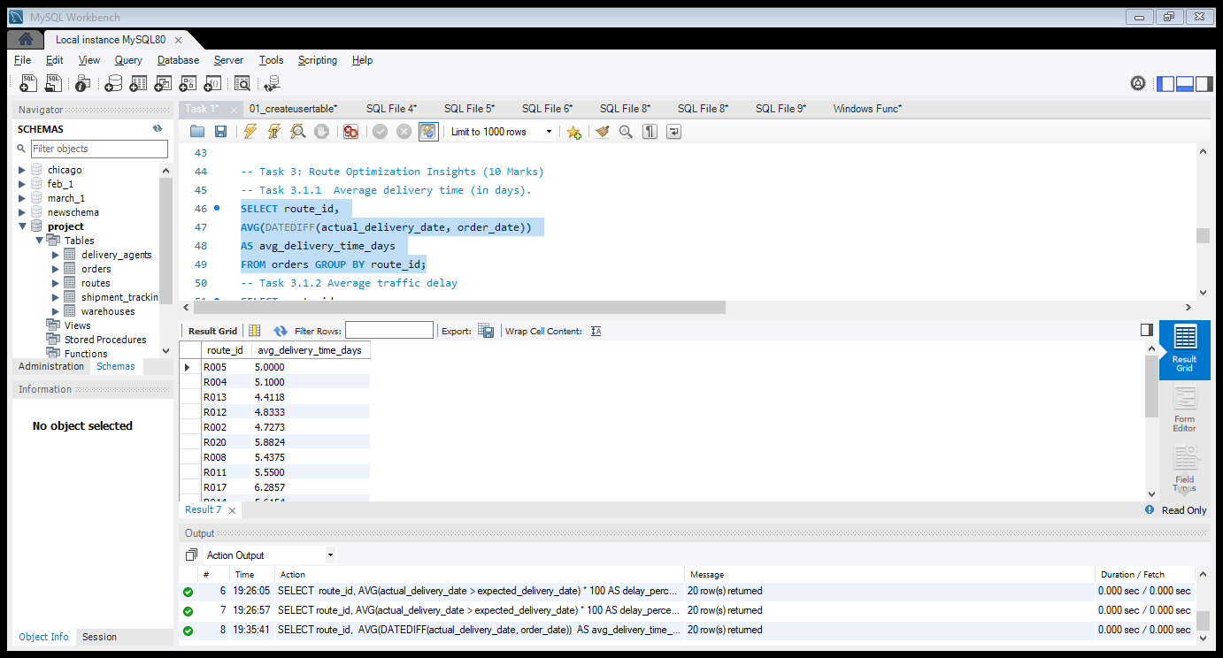
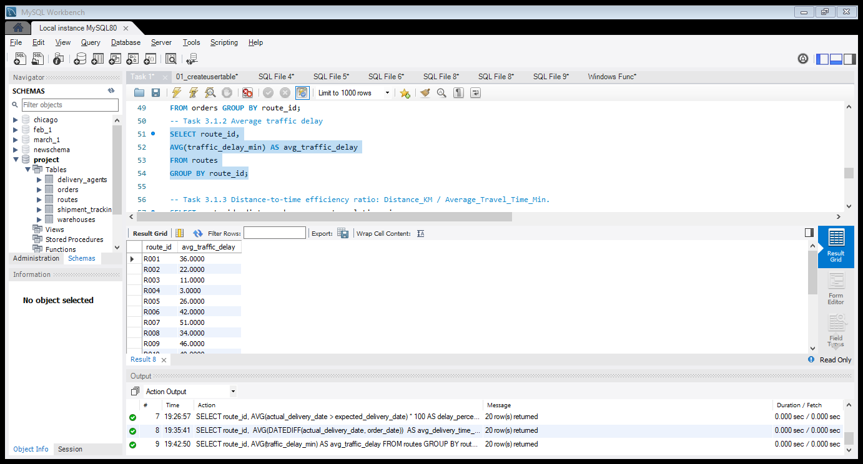
Task 3: Route Optimization Insights
Task 3.1.1 Average delivery time (in days) • SELECT route_id, AVG(DATEDIFF(actual_delivery_date, order_date)) AS avg_delivery_time_days FROM orders GROUP BY route_id; • Insights- This query calculates the average delivery time for orders on each route. Task 3.1.2 Average traffic delay • SELECT route_id, AVG(traffic_delay_min) AS avg_traffic_delay FROM routesGROUP BY route_id; • Insights- This analysis shows the average traffic delay experienced on each route.

Slide 13
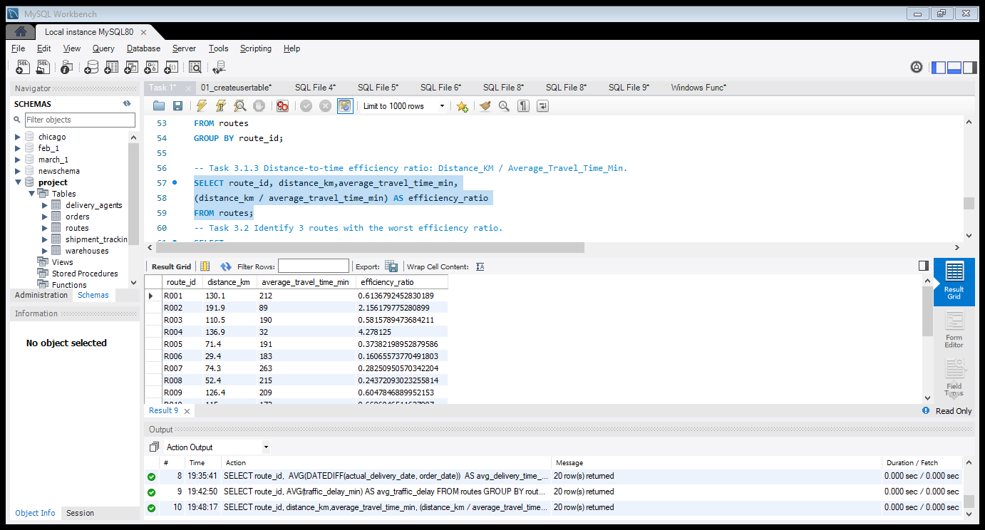
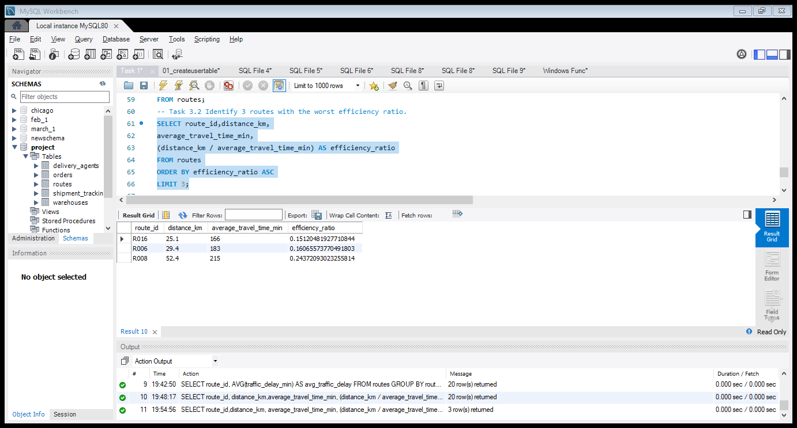
Task 3.1.3 Distance-to-time efficiency ratio: Distance_KM / Average_Travel_Time_Min.
• SELECT route_id, distance_km, average_travel_time_min, (distance_km / average_travel_time_min) AS efficiency_ratio FROM routes; • Insights- -Efficiency ratio measures route efficiency based on distance travelled per minute.
-Higher ratios indicate more efficient routes. Task 3.2 Identify 3 routes with the worst efficiency ratio. • SELECT route_id,distance_km, average_travel_time_min, (distance_km / average_travel_time_min) AS efficiency_ratio FROM routes ORDER BY efficiency_ratio ASC LIMIT 3;

Slide 14
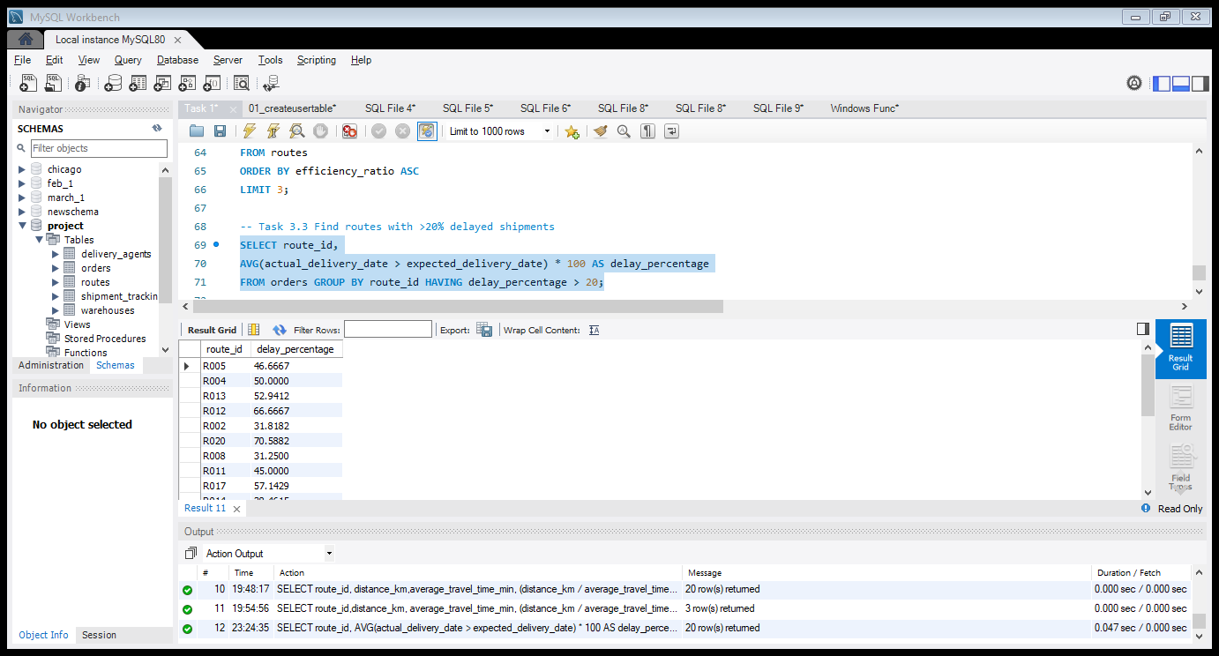
• Insights- Routes with the lowest efficiency ratios indicate poor route performance and may require optimization. Task 3.3 Find routes with >20% delayed shipments • SELECT route_id, AVG(actual_delivery_date > expected_delivery_date) * 100 AS delay_percentage FROM orders GROUP BY route_id HAVING delay_percentage > 20;

Slide 15
Insights- Routes with more than 20% delayed shipments were identified as high-risk routes requiring operational improvement. Task 3.4 Recommend potential routes for optimization
Routes with low efficiency ratios and high delay percentages indicate operational inefficiencies.
Potential improvements include:
• Optimizing route planning
• Reducing traffic congestion impact
• Improving warehouse dispatch coordination

Slide 16
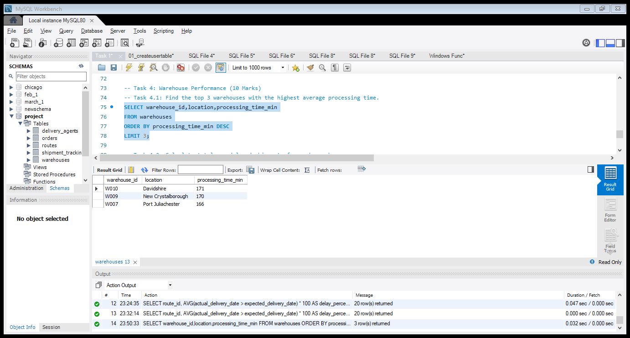
Task 4: Warehouse Performance
Task 4.1: Find the top 3 warehouses with the highest average processing time • SELECT warehouse_id, location,processing_time_min FROM warehouses ORDER BY processing_time_min DESC LIMIT 3; • Insights- Warehouses with the highest processing times may cause delays in shipment dispatch and should be optimized.

Slide 17
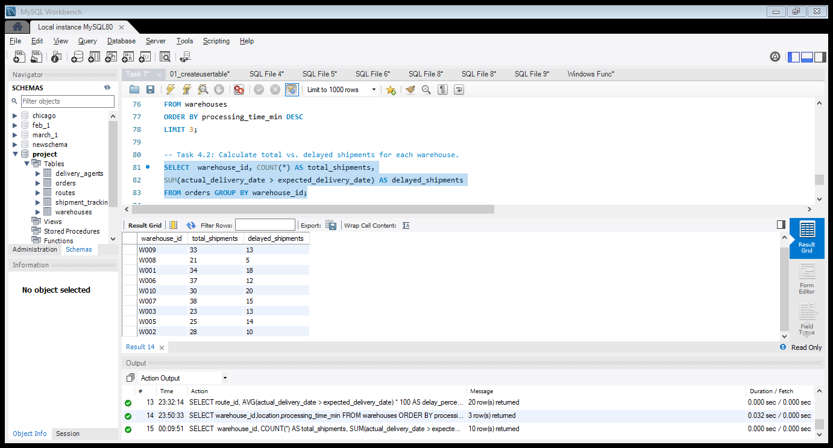
Task 4.2: Calculate total vs. delayed shipments for each warehouse
• SELECT warehouse_id, COUNT(*) AS total_shipments, SUM(actual_delivery_date > expected_delivery_date) AS delayed_shipments FROM orders GROUP BY warehouse_id; Insights- Some warehouses handle a higher number of delayed shipments, indicating possible operational inefficiencies.

Slide 18
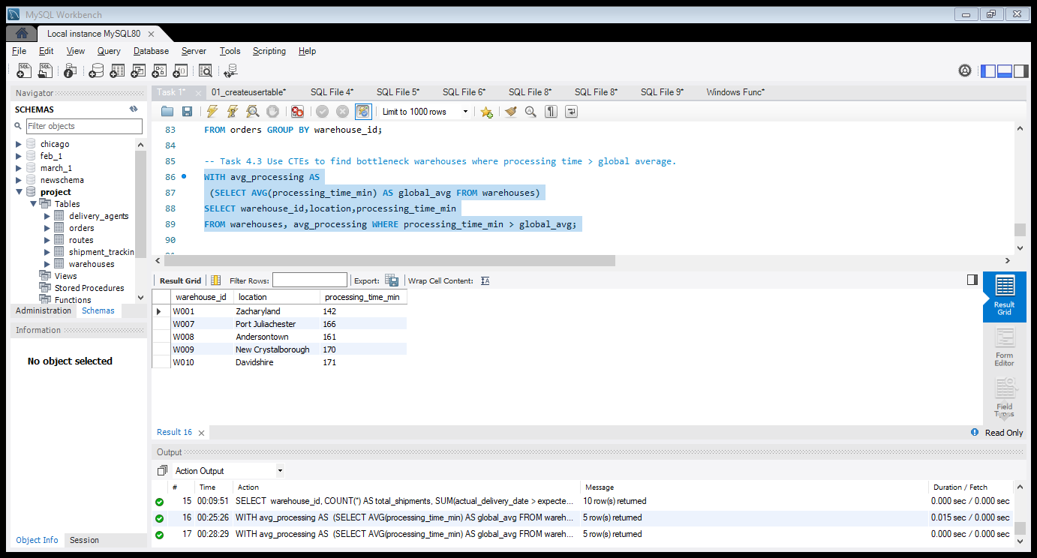
Task 4.3 Use CTEs to find bottleneck warehouses where processing time > global average
• WITH avg_processing AS (SELECT AVG(processing_time_min) AS global_avg FROM warehouses) SELECT warehouse_id,location, processing_time_min FROM warehouses, avg_processing WHERE processing_time_min > global_avg ; • Insights- Warehouses with processing time higher than the global average are identified as bottlenecks in the logistics network.

Slide 19
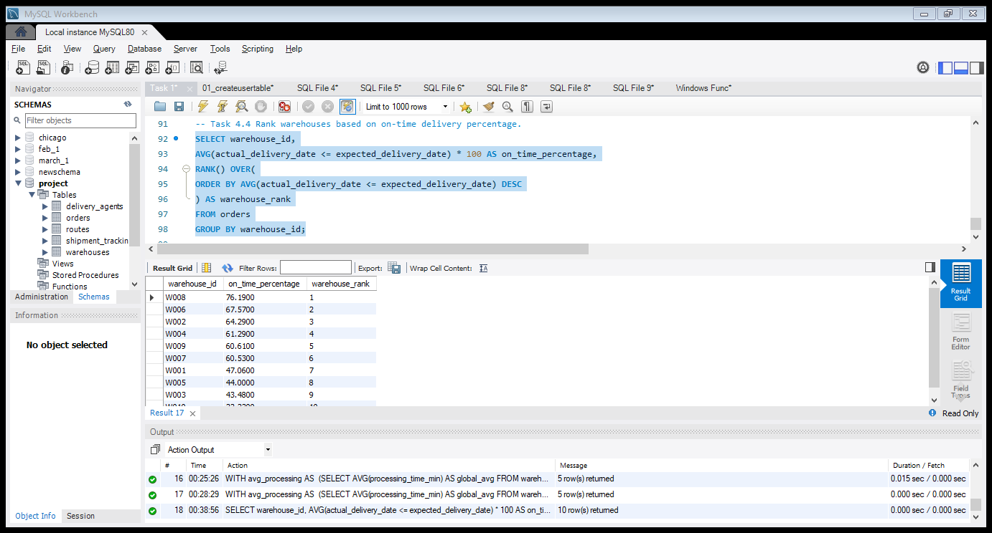
Task 4.4 Rank warehouses based on on-time delivery percentage
SELECT warehouse_id, AVG(actual_delivery_date <= expected_delivery_date) * 100 AS on_time_percentage, RANK() OVER(ORDER BY AVG(actual_delivery_date <= expected_delivery_date) DESC) AS warehouse_rank FROM orders GROUP BY warehouse_id; • Insights- Warehouses with higher on-time delivery percentages demonstrate better operational efficiency.

Slide 20
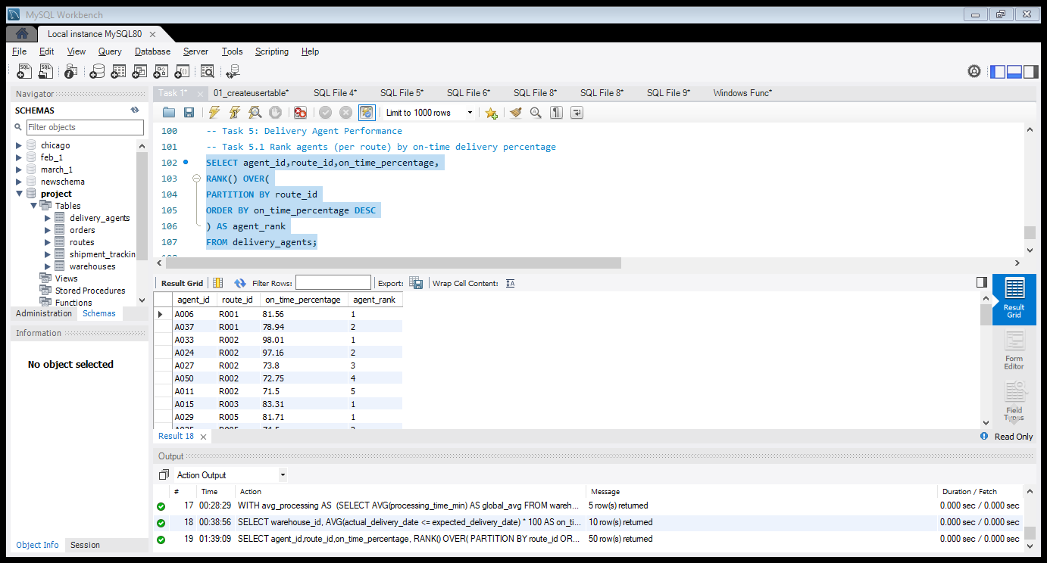
Task 5: Delivery Agent Performance
Task 5.1 Rank agents (per route) by on-time delivery percentage • SELECT agent_id,route_id,on_time_percentage, RANK() OVER(PARTITION BY route_id ORDER BY on_time_percentage DESC) AS agent_rank FROM delivery_agents; • Insights- Agents were ranked within each route based on on-time delivery percentage to identify top-performing agents.

Slide 21
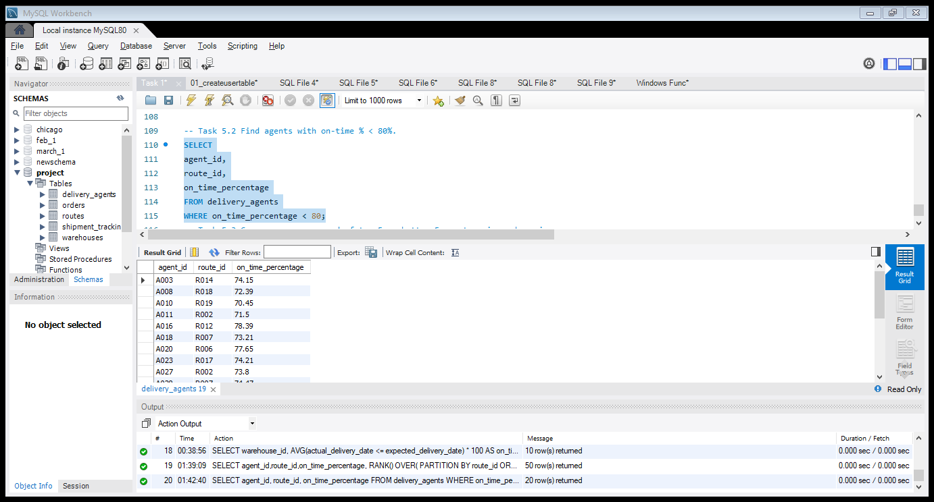
Task 5.2 Find agents with on-time % < 80%.
• SELECT agent_id, route_id, on_time_percentage FROM delivery_agents WHERE on_time_percentage < 80; • Insights- Agents with on-time delivery percentage below 80% were identified as potential performance risks.

Slide 22
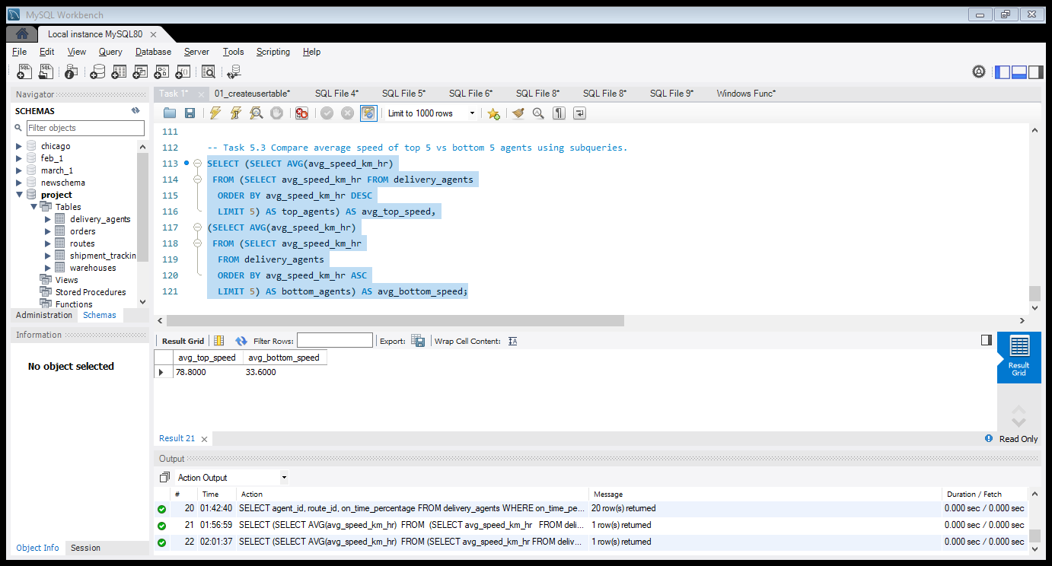
Task 5.3 Compare average speed of top 5 vs bottom 5 agents using subqueries
• SELECT (SELECT AVG(avg_speed_km_hr) FROM (SELECT avg_speed_km_hr FROM delivery_agents ORDER BY avg_speed_km_hr DESC LIMIT 5) AS top_agents) AS avg_top_speed, (SELECT AVG(avg_speed_km_hr) FROM (SELECT avg_speed_km_hr FROM delivery_agents ORDER BY avg_speed_km_hr ASC LIMIT 5) AS bottom_agents) AS avg_bottom_speed; • Insights- Top-performing delivery agents maintain significantly higher average speeds compared to bottom-performing agents.
This difference may impact delivery efficiency and route performance.

Slide 23
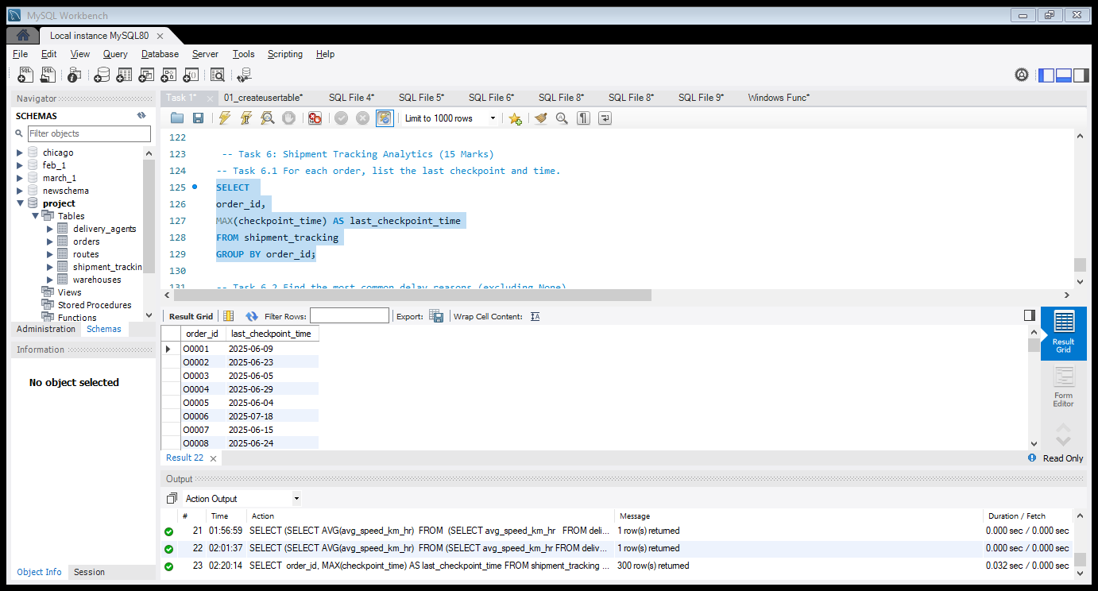
Task 6: Shipment Tracking Analytics
Task 6.1- For each order, list the last checkpoint and time • SELECT order_id,MAX(checkpoint_time) AS last_checkpoint_time FROM shipment_tracking GROUP BY order_id; • Insights- The latest checkpoint time for each order was identified to track the most recent shipment location.

Slide 24
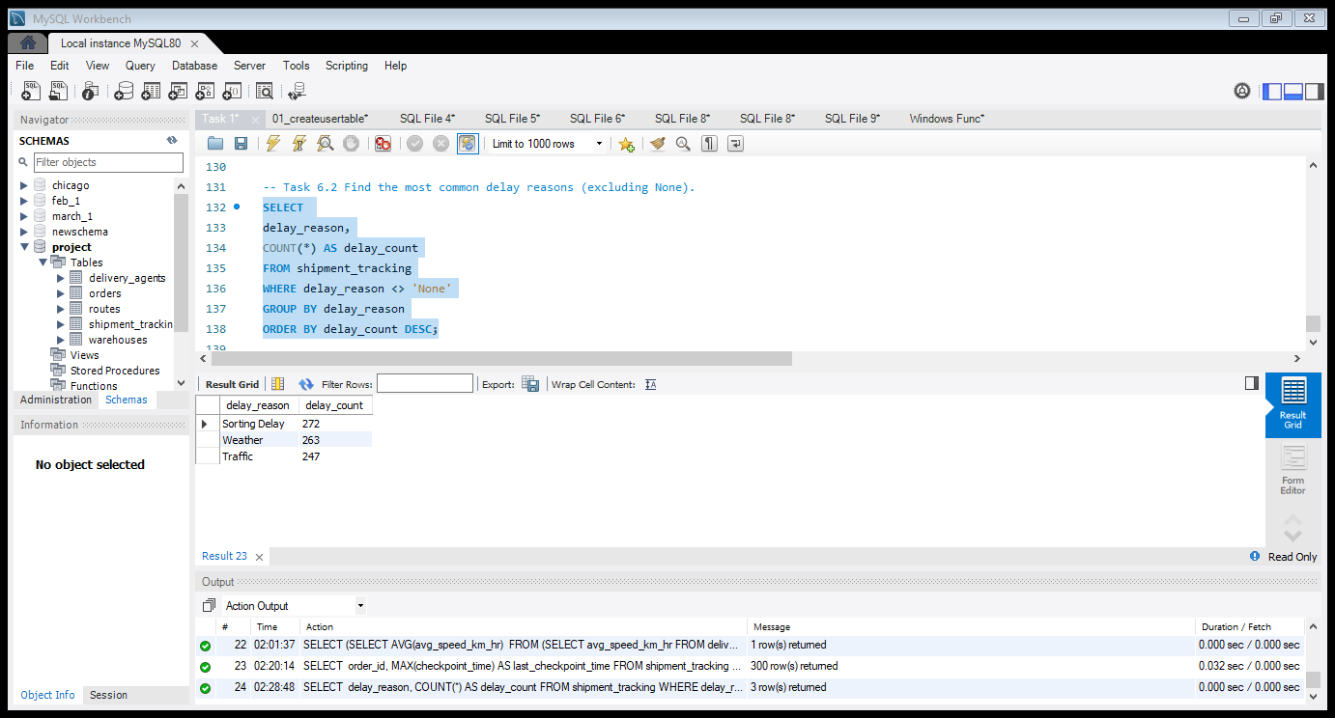
Task 6.2 Find the most common delay reasons (excluding None)
• SELECT delay_reason, COUNT(*) AS delay_count FROM shipment_tracking WHERE delay_reason <> 'None’ GROUP BY delay_reason ORDER BY delay_count DESC; • Insights- Traffic and weather conditions are the most frequent causes of shipment delays.

Slide 25
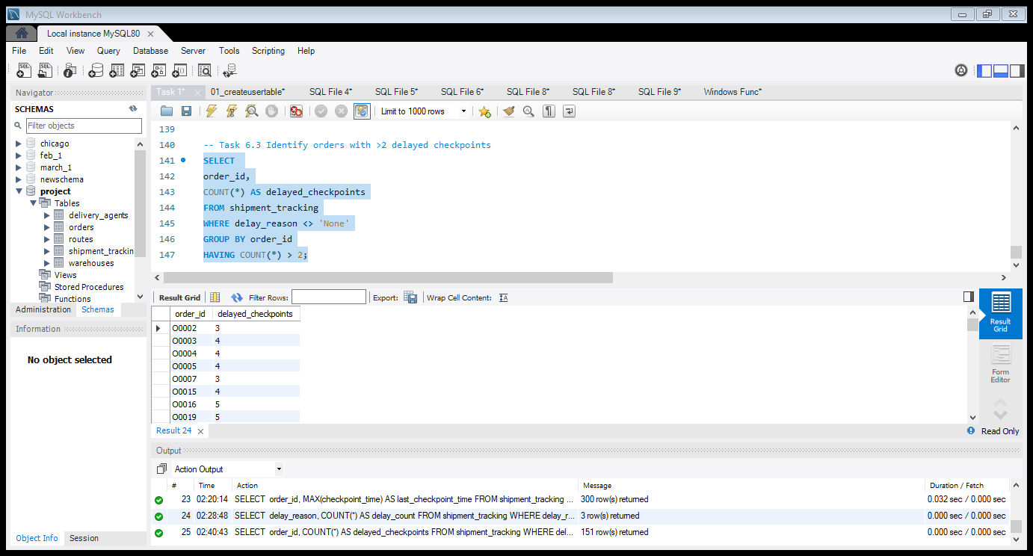
Task 6.3 Identify orders with >2 delayed checkpoints
• SELECT order_id, COUNT(*) AS delayed_checkpoints FROM shipment_tracking WHERE delay_reason <> 'None’ GROUP BY order_id HAVING COUNT(*) > 2; • Insights- Orders with more than two delayed checkpoints indicate severe shipment disruption during transit.

Slide 26
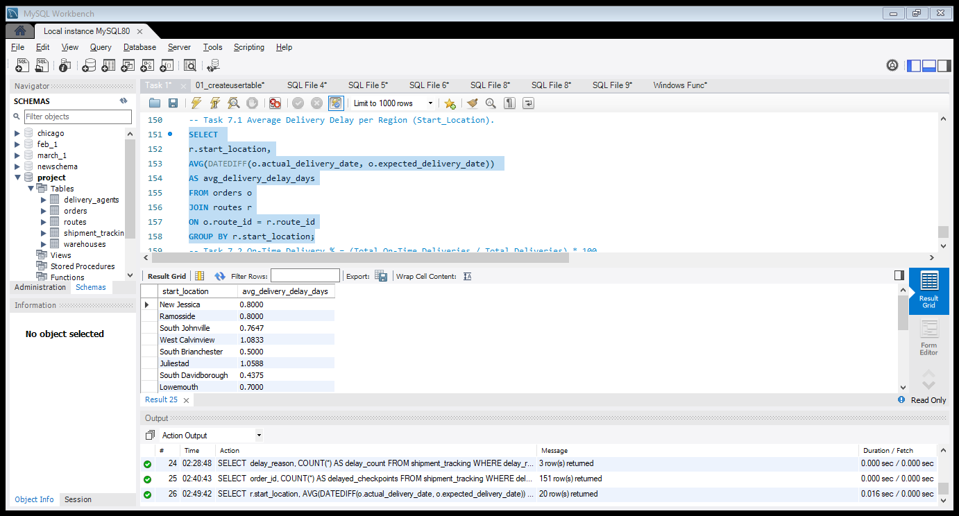
Task 7: Advanced KPI Reporting
Task 7.1 Average Delivery Delay per Region (Start_Location) • SELECT r.start_location, AVG(DATEDIFF(o.actual_delivery_date, o.expected_delivery_date)) AS avg_delivery_delay_days FROM orders o JOIN routes r ON o.route_id = r.route_id GROUP BY r.start_location ; • Insights- Certain regions experience higher delivery delays compared to others, which may indicate route congestion or operational challenges.

Slide 27
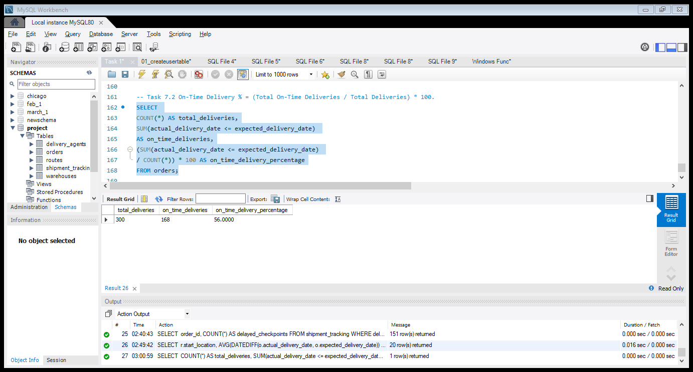
Task 7.2 On-Time Delivery % = (Total On-Time Deliveries / Total Deliveries) * 100
• SELECT COUNT(*) AS total_deliveries, SUM(actual_delivery_date <= expected_delivery_date) AS on_time_deliveries, (SUM(actual_delivery_date <= expected_delivery_date) / COUNT(*)) * 100 AS on_time_delivery_percentage FROM orders; • Insights- Out of 300 total deliveries, 168 deliveries were completed on time,
resulting in an on-time delivery rate of 56%, while 44% of shipments
experienced delays.

Slide 28
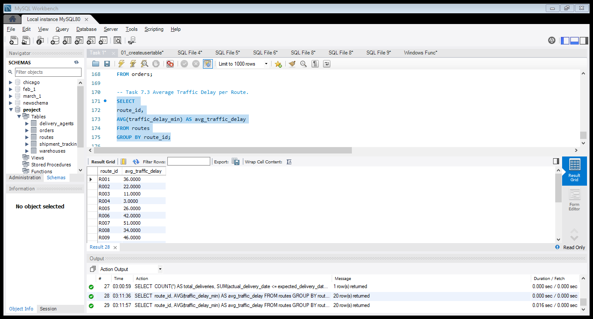
Task 7.3 Average Traffic Delay per Route.
• SELECT route_id, AVG(traffic_delay_min) AS avg_traffic_delay FROM routes GROUP BY route_id; • Insights- Routes with higher average traffic delays may require route optimization or improved delivery scheduling.

Slide 29
Key Insights :-
• Certain routes show consistently high delivery delays
• Traffic and weather are major delay factors
• Some warehouses have higher processing times (bottlenecks)
• A group of delivery agents has low on-time performance (<80%)
• Multiple delay checkpoints indicate severe shipment disruption Recommendations:- • Optimize high-delay routes using better route planning
• Reduce traffic impact using real-time navigation systems
• Improve warehouse processing efficiency
• Provide training for low-performing delivery agents
• Monitor shipments with multiple delay checkpoints more closely

Slide 30
Final Conclusion :-
This project successfully analyzed logistics data using SQL to identify delays,
inefficiencies, and performance issues across routes, warehouses, and delivery agents.
The insights generated can help improve delivery efficiency, reduce delays,
and enhance overall logistics performance. Video Explanation link https://www.loom.com/share/94d5e8e3d5ae43d2b9775877613f55ac

